Slide 1

Gihan Dias
Sulochana Sooriarachchi
CS2032 – Principles of Computer Communication

Slide 2
Lesson Outcomes
After successful completion of this lesson you will be able to:
  Categorize different technologies of transmission media
  Explain concepts behind the functioning of media

Slide 3

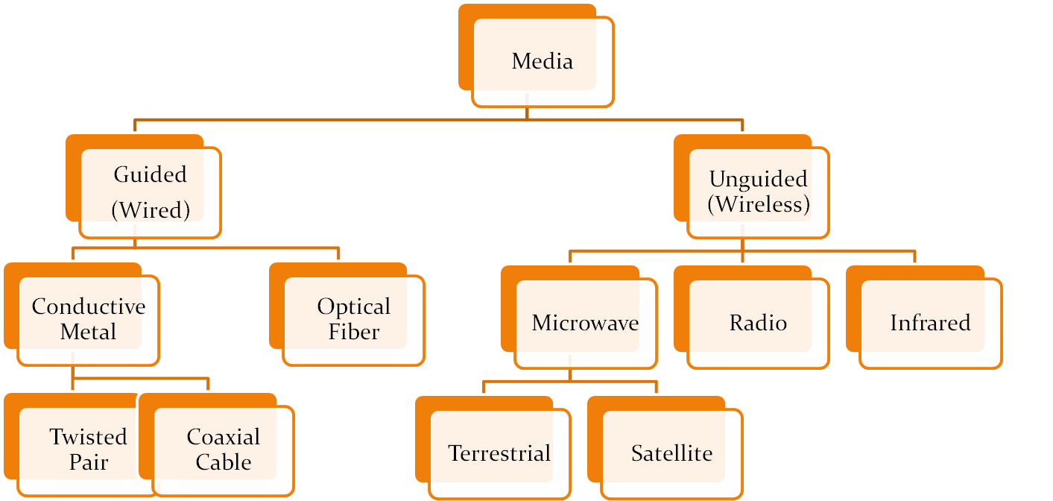

Slide 4
Characteristics of Media
Cost
Data Rate
Bandwidth
  higher bandwidth gives higher data rate
transmission impairments
  eg. attenuation
Interference
  Causes: electric motors, lightning strikes, other wires, spark
number of receivers in guided media
  more receivers introduces more attenuation

Slide 5


Slide 6
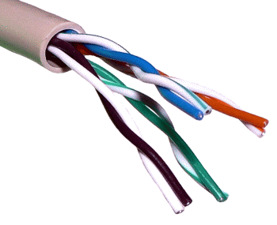
Twisted Pair
Copper
  Conductive
  Resistance to corrosion
Twist
  Straight copper act as antennas and pick extraneous signals
  Insulated copper wires are twisted
  Twist reduces signal interference between pairs (Crosstalk)
Distance causes signals to lose strength (Attenuation)

Slide 7
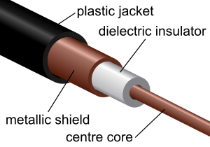
Coaxial Cable
Metallic shield is a wire mesh
  Protect signals from electromagnetic interference
Can transmit in
  Baseband mode: bandwidth devoted for single stream of data
  Broadband mode: multiple signals over multiple channels

Slide 8
Unshielded vs Shielded TP
unshielded Twisted Pair (UTP)
  ordinary telephone wire
  cheapest
  easiest to install
  suffers from external EM interference
shielded Twisted Pair (STP)
  metal braid or sheathing that reduces interference
  more expensive
  harder to handle (thick, heavy)
in a variety of categories - see EIA-568
Dept. of Computer Science & Engineering, 2008

Slide 9
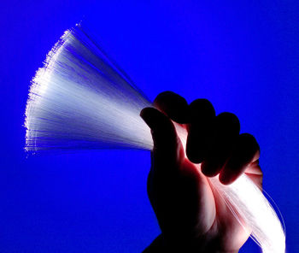
Optical Fiber
Light waves in place of electricity
Long distance transmission
  Impervious to electrical noise
  Large capacity
  Very thin, therefore can bundle large numbers in manageable sized cables

Slide 10

Basics of
Optical Fiber
Light Source
Reflected Light
1
α
α
Interface between two media
β
2
Refraction
  if medium 2 has higher optical density
  if medium 1 has higher optical density
Index of refraction
  Index < 1 : light travel to less optically dense medium
  Index>1: light travel to more optically dense medium
When α is less than a critical angle, there is no refracted light
β>α
Refracted Light
α>β

Slide 11
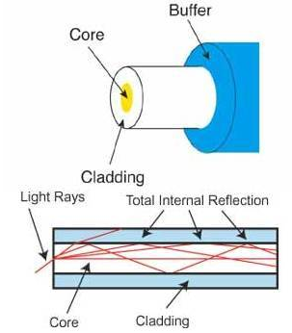
Basics of Optical Fiber…(2)
Light source
  LED or Laser
  Short rapid light pulses at different angles
Light bounces boundary to boundary and propagate
Detected by a sensor at the receiver
Finite number of angles possible
  Each angle defines a path or mode
  Step Index Multimode Fiber

Slide 12
Basics of Fiber (3)
Modal Dispersion: larger the angle of reflection faster it reaches destination and vice versa
  Light from one pulse catch light from other and viewed by sensor as a steady stream of light ➔ loss of coded data
Graded Index Multimode Fiber:
  Reduce modal dispersion by making material become gradually less dense when moving out radially from core
Single Mode Fiber:
  Reduce core diameter until single angle of light is possible

Slide 13
Advantages of Optical Fiber
Can transmit more data than conductive metal
Less resistance to light, can travel far without repeaters
Not affected by electro magnetic interference
High resistance to environmental elements like humidity
However, a level of complexity is added because of the need for conversion from light to electrical signals and vice versa

Slide 14


No physical connection

Slide 15
Basics
Oscillating electromagnetic waves of a transmitting antenna
Travels through air (free space)
Sensed by receiving antenna

Slide 16
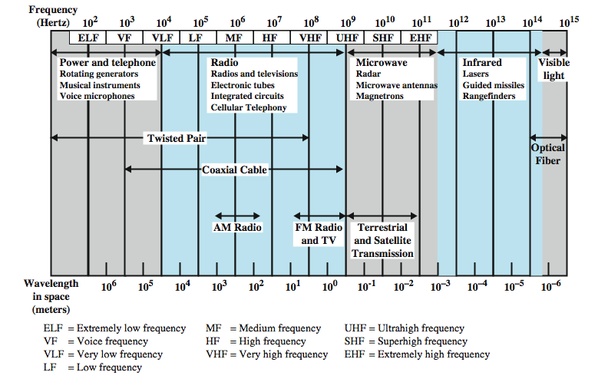
Electromagnetic Wave Spectrum

Slide 17
Wireless Transmission Frequencies
2GHz to 40GHz
  microwave
  highly directional
  point to point
  satellite
30MHz to 1GHz
  omnidirectional
  broadcast radio
3 x 10¹¹ to 2 x 10¹⁴
  infrared
  local
Dept. of Computer Science & Engineering, 2008

Slide 18
Antennas
electrical conductor used to radiate or collect electromagnetic energy
transmission antenna
  radio frequency energy from transmitter
  converted to electromagnetic energy by antenna
  radiated into surrounding environment
reception antenna
  electromagnetic energy impinging on antenna
  converted to radio frequency electrical energy
  fed to receiver
same antenna is often used for both purposes
Dept. of Computer Science & Engineering, 2008

Slide 19
Radiation Pattern
power radiated in all directions
not same performance in all directions
  as seen in a radiation pattern diagram
an isotropic antenna is a (theoretical) point in space
  radiates in all directions equally
  with a spherical radiation pattern
Dept. of Computer Science & Engineering, 2008

Slide 20
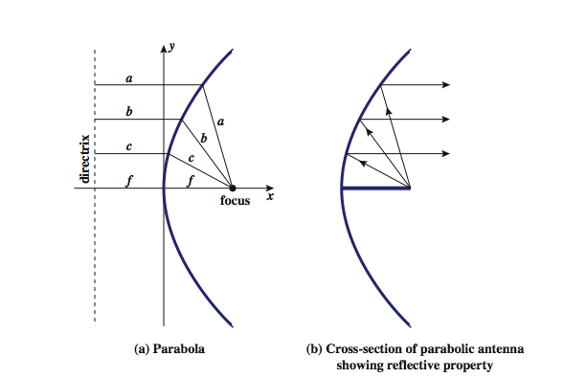
Parabolic Reflective Antenna
Dept. of Computer Science & Engineering, 2008

Slide 21
Antenna Gain
measure of directionality of antenna
power output in particular direction verses that produced by an isotropic antenna
measured in decibels (dB)
results in loss in power in another direction
effective area relates to size and shape
  related to gain
Dept. of Computer Science & Engineering, 2008

Slide 22
Terrestrial Microwave
used for long haul telecommunications
and short point-to-point links
requires fewer repeaters but line of sight
use a parabolic dish to focus a narrow beam onto a receiver antenna
1-40GHz frequencies
higher frequencies give higher data rates
main source of loss is attenuation
  distance, rainfall
also interference
Dept. of Computer Science & Engineering, 2008

Slide 23
Satellite Microwave
satellite is relay station
receives on one frequency, amplifies or repeats signal and transmits on another frequency
  eg. uplink 5.925-6.425 GHz & downlink 3.7-4.2 GHz
typically requires geo-stationary orbit
  height of 35,784km
  spaced at least 3-4° apart
typical uses
  television
  long distance telephone
  private business networks
  global positioning
Dept. of Computer Science & Engineering, 2008

Slide 24
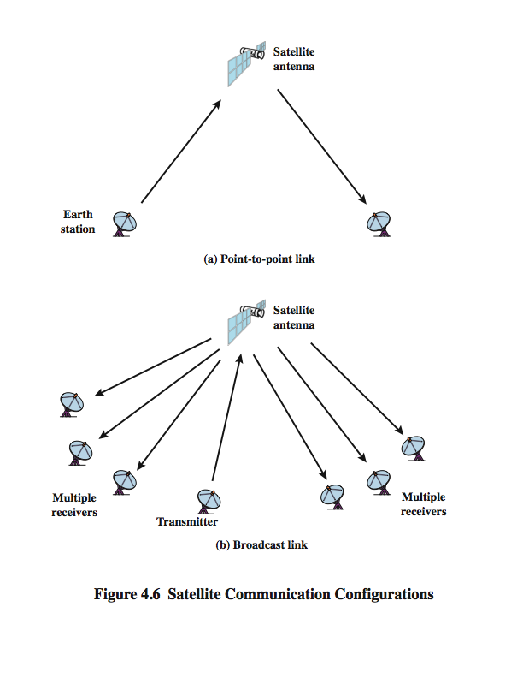
Satellite Communication Configuration

Slide 25
Broadcast Radio
radio is 3kHz to 300GHz
use broadcast radio, 30MHz - 1GHz, for:
  FM radio
  UHF and VHF television
is omnidirectional
still need line of sight
suffers from multipath interference
  reflections from land, water, other objects
Dept. of Computer Science & Engineering, 2008

Slide 26
Infrared
modulate non-coherent infrared light
end line of sight (or reflection)
are blocked by walls
no licenses required
typical uses
  TV remote control
  IRD port
Dept. of Computer Science & Engineering, 2008

Slide 27
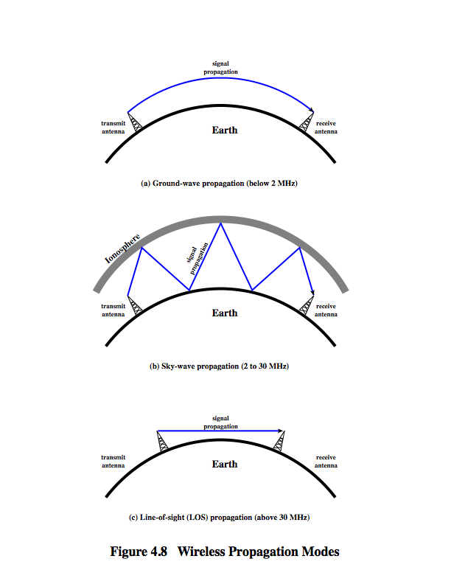
Wireless Propagation
Ground Wave
Waves follow earth’s curvature and propagate despite obstacles due to;
  Currents induced by waves on the earth’s surface cause the wavefront to slow down tilt downward
  Diffraction at obstacles

Slide 28
Wireless Propagation
Sky Wave
Refraction causes waves to bounce back and forth between earth’s surface and the ionosphere (ionizes layer of upper atmosphere)

Slide 29
Wireless Propagation
Line of Sight
Neither refraction no ground wave propagation works for high frequency waves above 30MHz
  Need Satallites
At ground level antennas must be places at effective line of sight
  “effective” distance depends on bent of waves with earth curvature and refraction by atmosphere

Slide 30
Line of Sight Transmission
Free space loss
  loss of signal with distance
Atmospheric Absorption
  from water vapour and oxygen absorption
Multipath
  multiple interfering signals from reflections
Refraction
  bending signal away from receiver
Dept. of Computer Science & Engineering, 2008

Slide 31

Common to both guided and unguided media

Slide 32
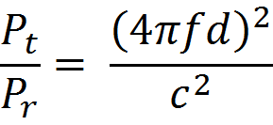

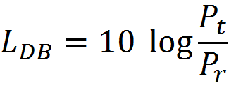
Free Space Loss
Attenuation due to spread of the signal over large area
Expressed by ratio of Radiated Power to Received Power

Slide 33
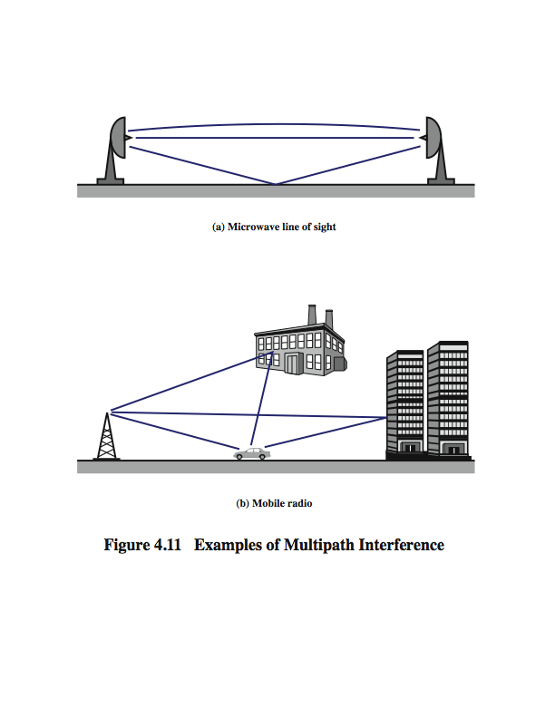
Multipath Interference
Signal is reflected by obstacles and multiple copies of the signal reaches the receiver with varying delays
In microwave, signal may refract and also go through curve paths so that it will reflect from ground
Dept. of Computer Science & Engineering, 2008

Slide 34


Slide 35
Standards
V-Series: for telephone communication
X Series: for interfaces
(by CCITT – Comete` Consultatif Internationale de Te`le`graphique at Te`le`phonique = International Consultative Committee for Telephony and Telegraphy)
EIA – electrical connections and physical transfer of data between devices
IEEE – LAN, WAN, Wireless..
  We will cover IEEE 802 Wired and Wireless Communication

Slide 36


